Slide 1
Introduction
Spatial Epidemiology in R
EPI 264 – Week 1
Fall 2019

Slide 2
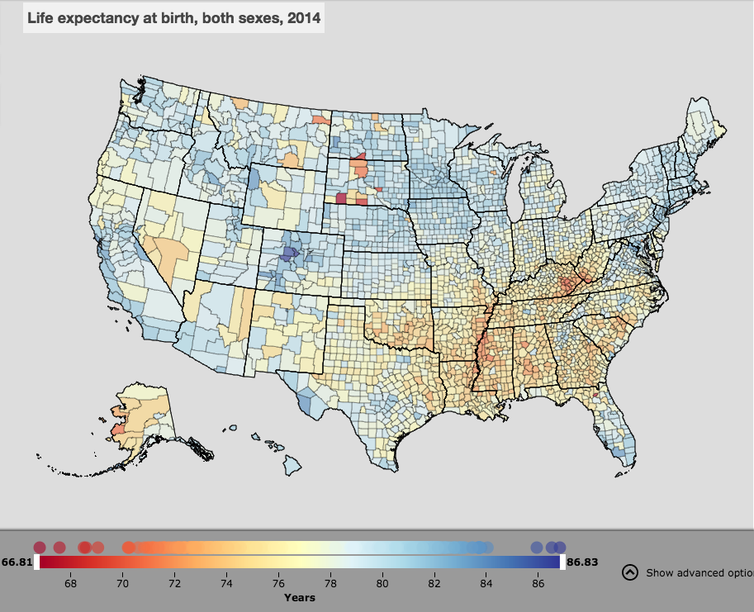

Slide 3
Course Objectives
Review types of data you may handle
Explore tools/software to visualize, explore and analyze spatial data
Learn techniques available for visualising, exploring and analyzing data
Learn to love R!

Slide 4


The Team
Ricardo Andrade-Pacheco
Hugh Sturrock
Adam Bennett
Francois Rerolle
Amanda Irish

Slide 5
Overview of topics covered
Concepts of spatial epidemiology
Manipulating and relating spatial data
Spatial variation in risk
Cluster analysis
Working with remote sensing data
Spatial regression analysis

Slide 6
Grades
Labs (0%)
Each week we will post a lab for you to work through on your own time
Labs are for practice, they are NOT graded
Assignments (20%)
Each week you will be asked to complete an assignment using rMarkdown
Final (80%)
This will be a written piece, should be journal article-esque
Include spatial analysis on dataset (supplied by us or your own dataset) incorporating topics covered across the 8 weeks

Slide 7
Visualizing Spatial Data
Spatial Epidemiology in R
EPI 264 – Week 1
Fall 2019

Slide 8
Spatial epidemiology
Spatial epidemiology is the description and analysis of geographic variations in disease with respect to demographic, environmental, behavioral, socioeconomic, genetic, and infectious risk factors.
From Elliott P, Wartenberg D. Spatial epidemiology: current approaches and future challenges. Environ Health Perspect. 2004;112(9):998–1006. doi:10.1289/ehp.6735

Slide 9
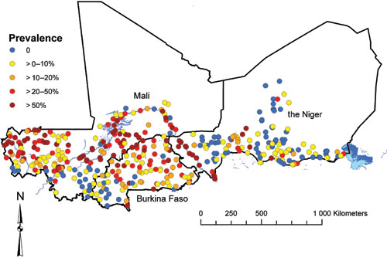
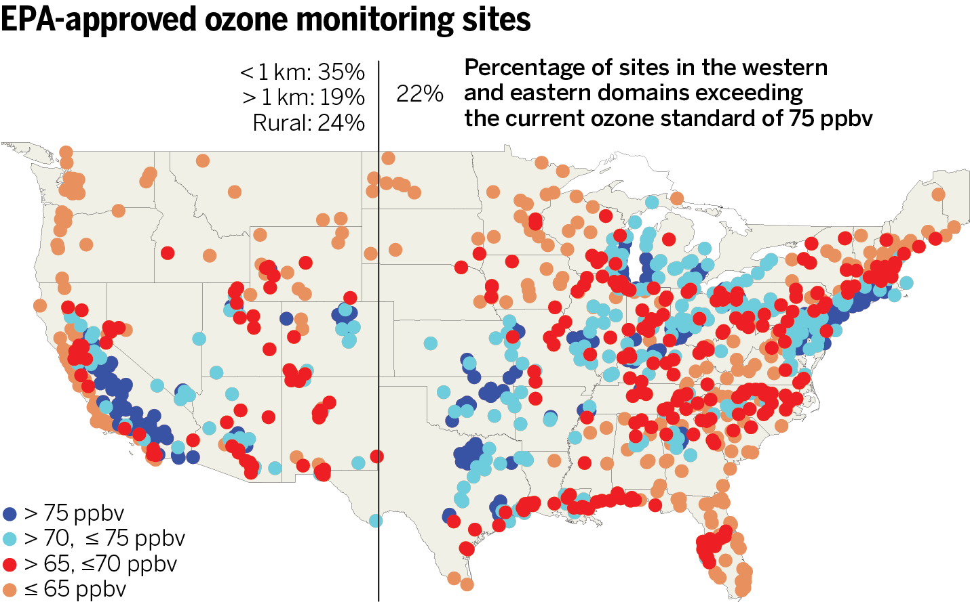
Spatial Data Types
Point level data
Schistosomiasis in Mali
Clements et al (2009) PLoS Negl Trop Dis 3(5): e431

Slide 10
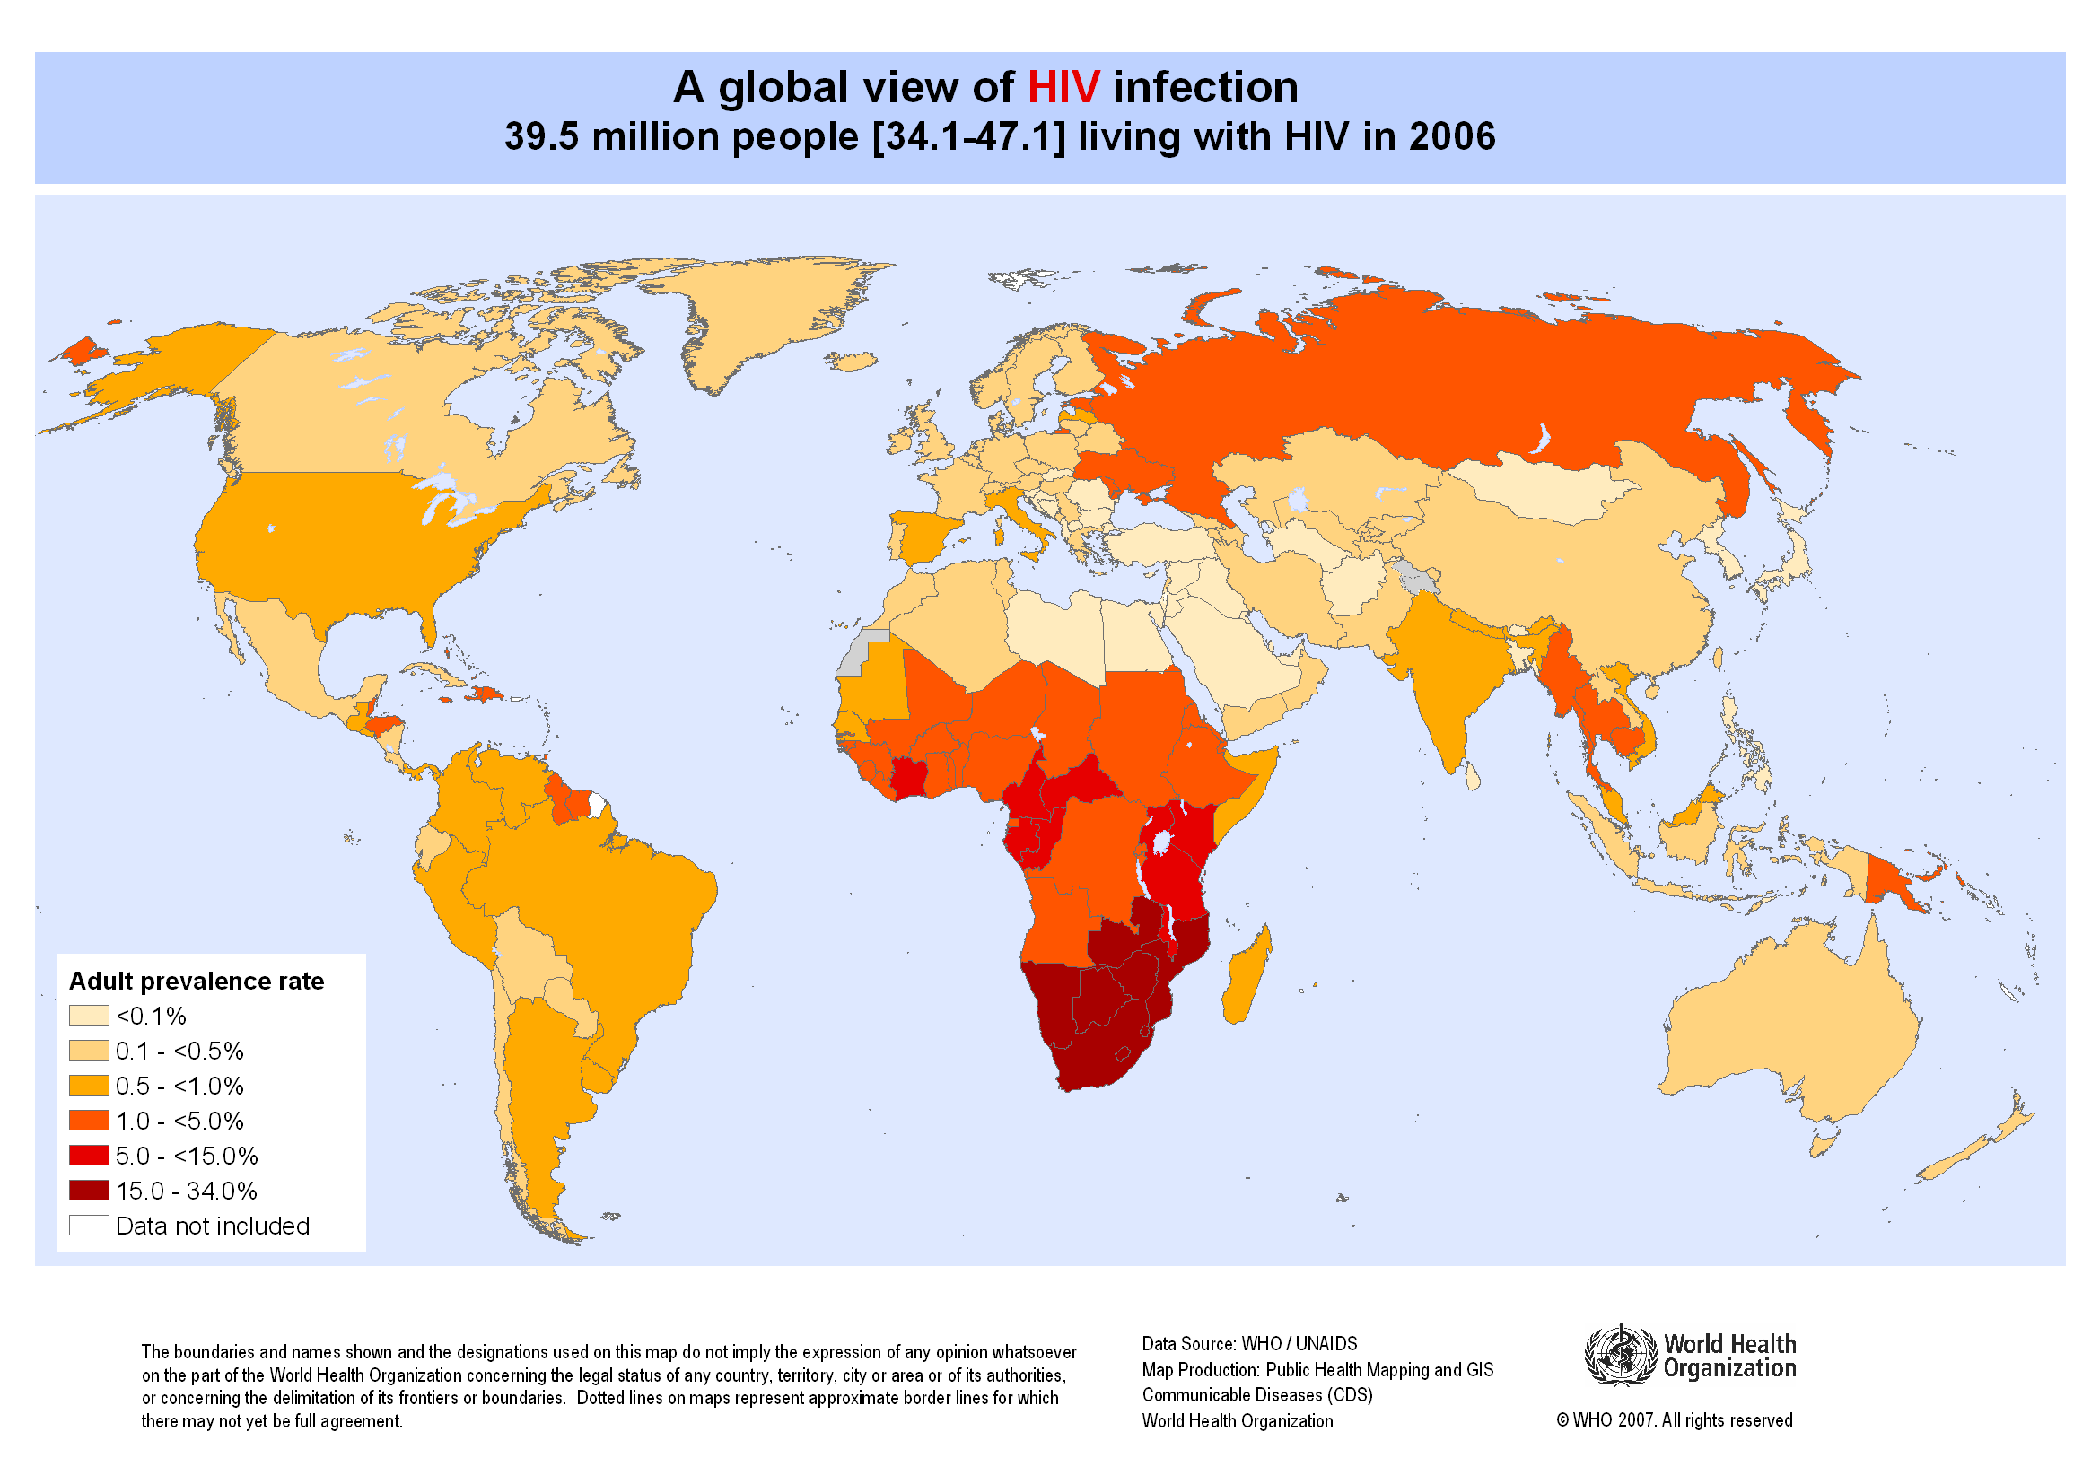
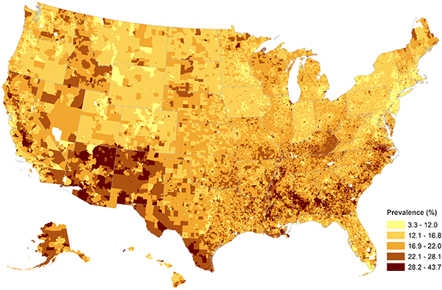
Spatial Data Types
Aggregate data
Childhood Obesity Prevalence at the Census Block-Group Level

Slide 11
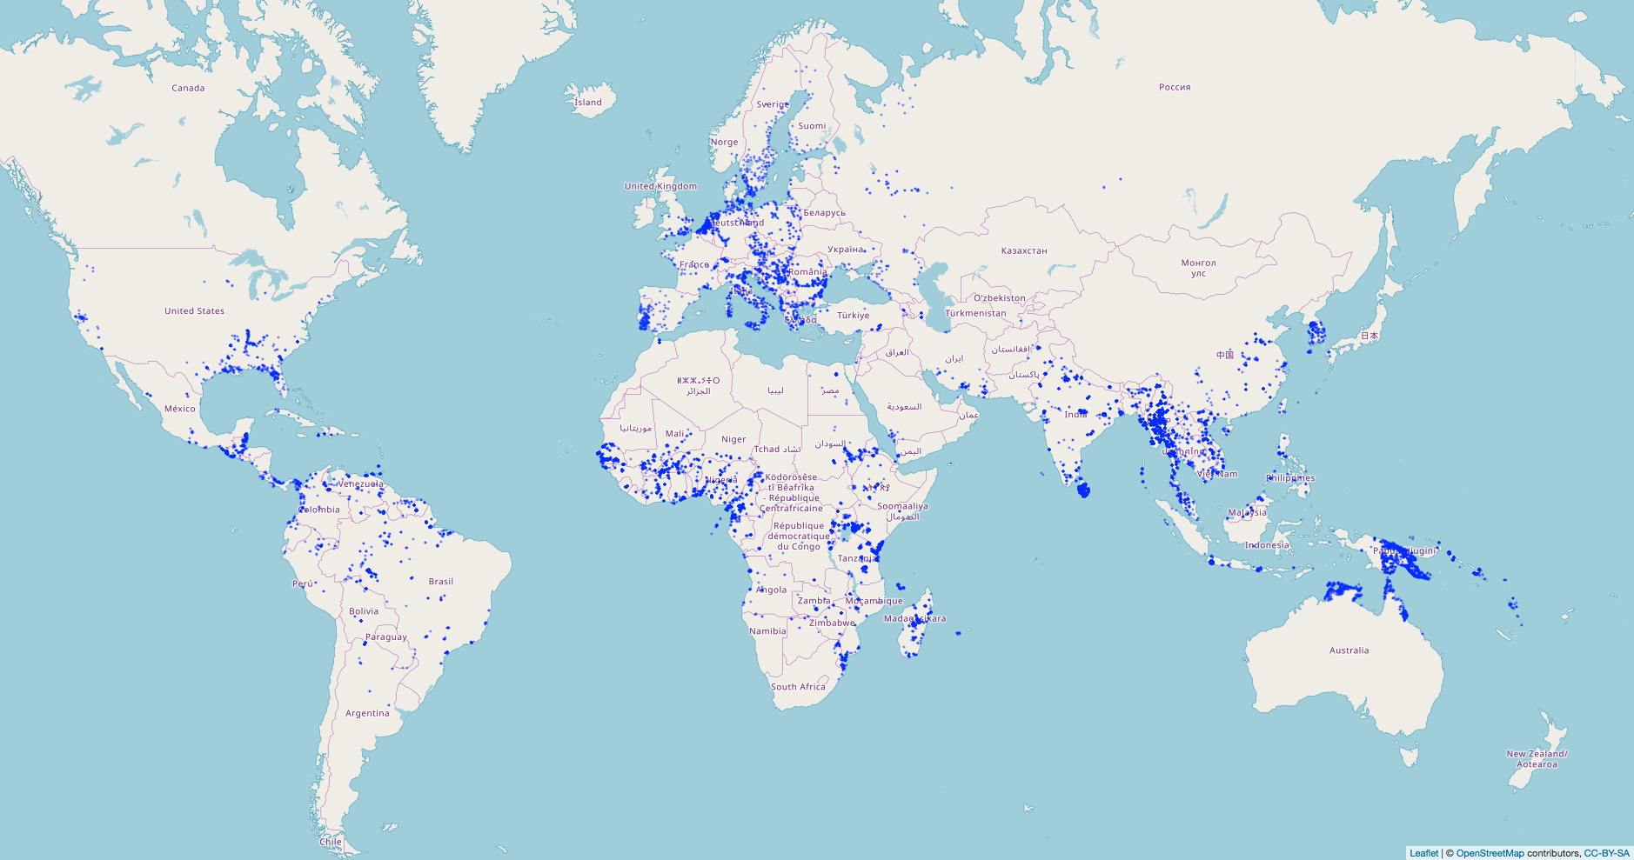
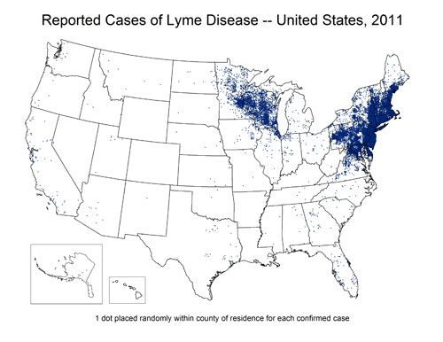
Spatial Data Types
Point process data
Presence of malaria vectors

Slide 12
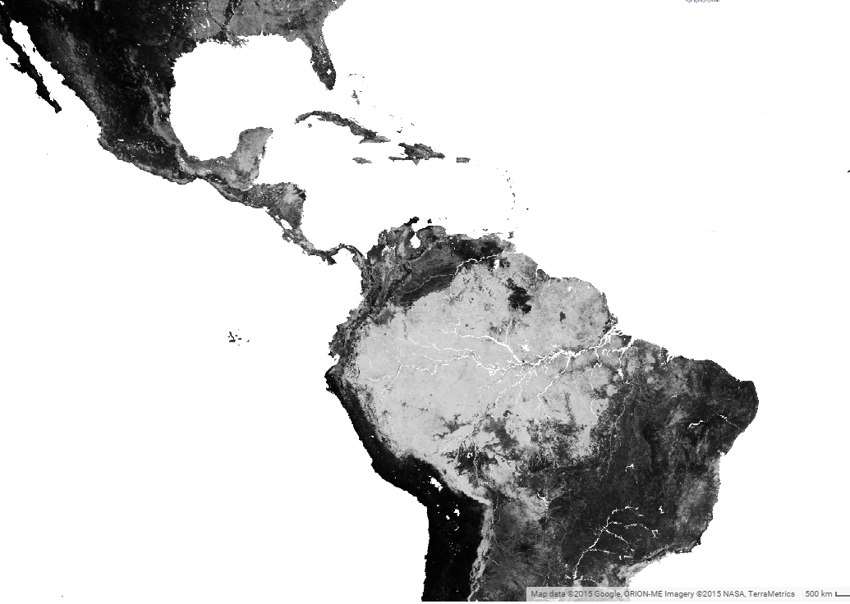
Spatial Data Types
Raster Data
Example: remotely sensed data – provide complete coverage at the spatial resolution of the sensor
Percentage tree cover

Slide 13
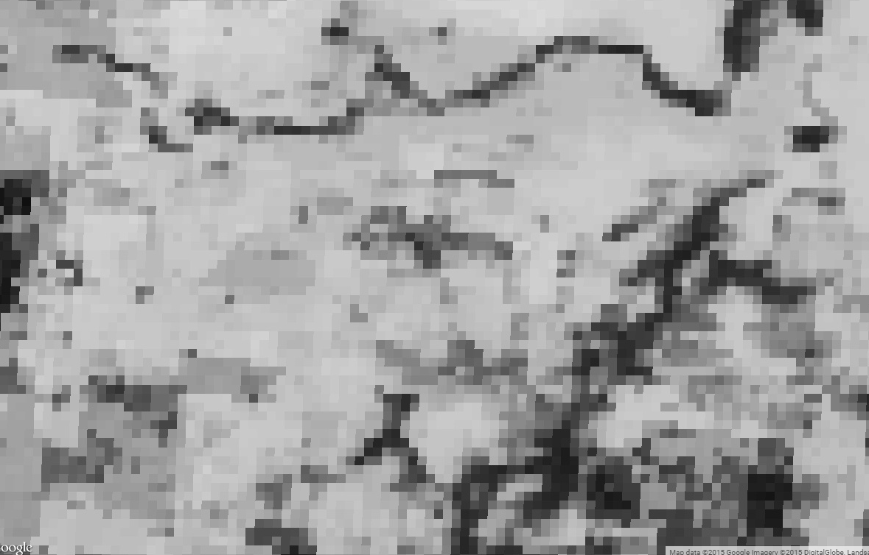
Spatial Data Types
Raster Data
Example: remotely sensed data – provide complete coverage at the spatial resolution of the sensor

Slide 14
Visualization
Exploration
Analysis

Slide 15
Visualization
Exploration
Analysis

Slide 16
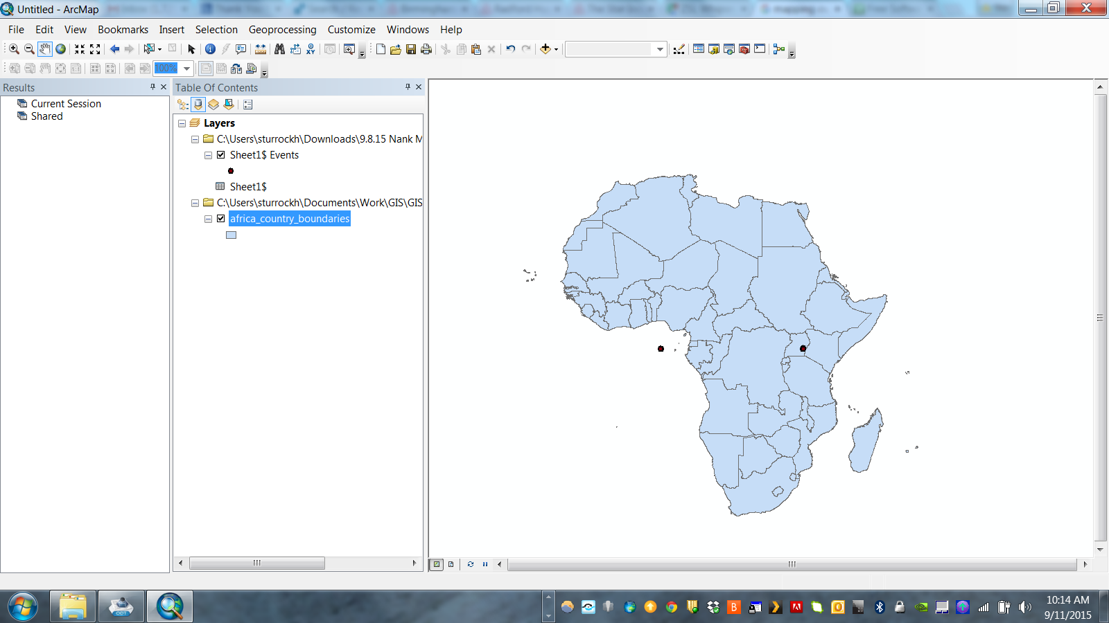
1. Identify Errors/Outliers

Slide 17
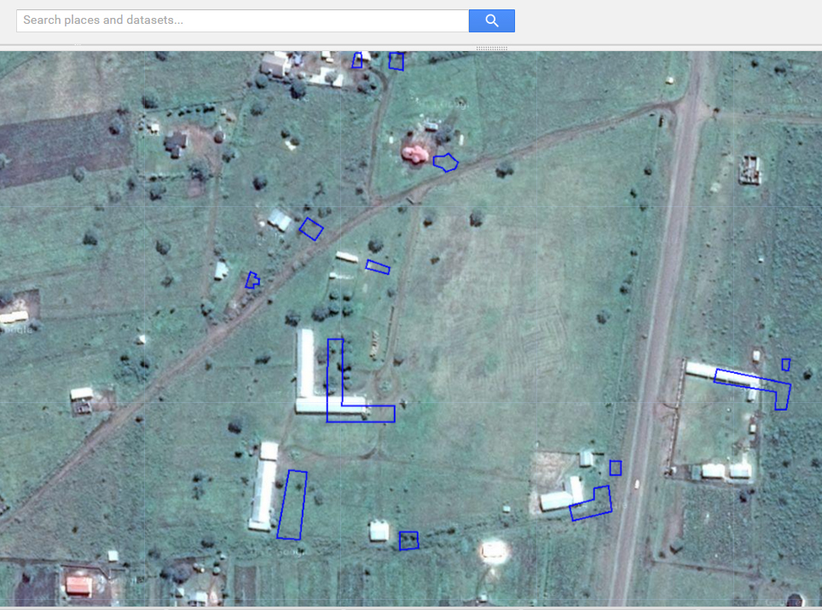
1. Identify Errors/Outliers

Slide 18
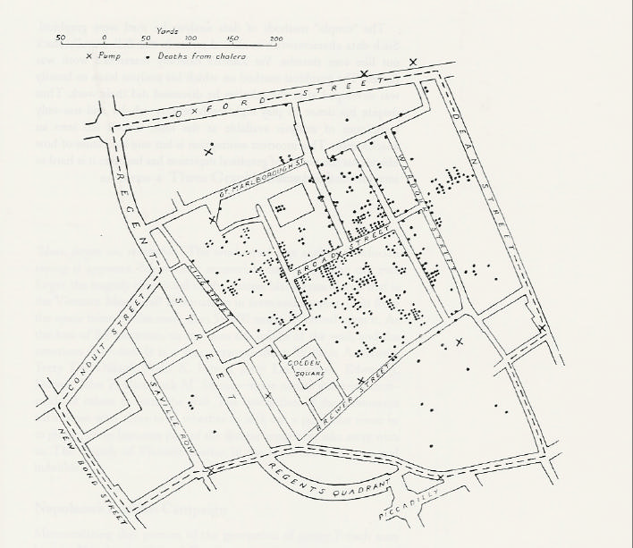
2. Identify Trends

Slide 19

https://www.youtube.com/watch?v=2jOtehF01Kc

Slide 20
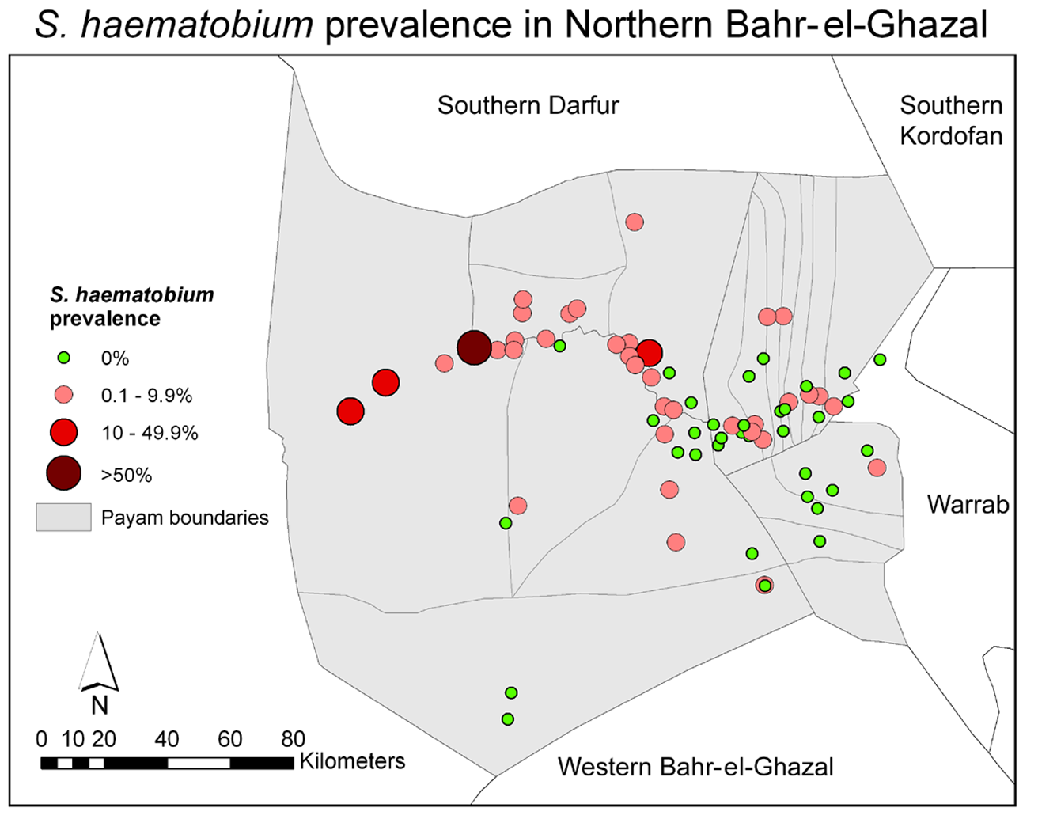
Mapping Point Level Data
Sturrock et al (2010) PLoS Negl Trop Dis 3(10)

Slide 21
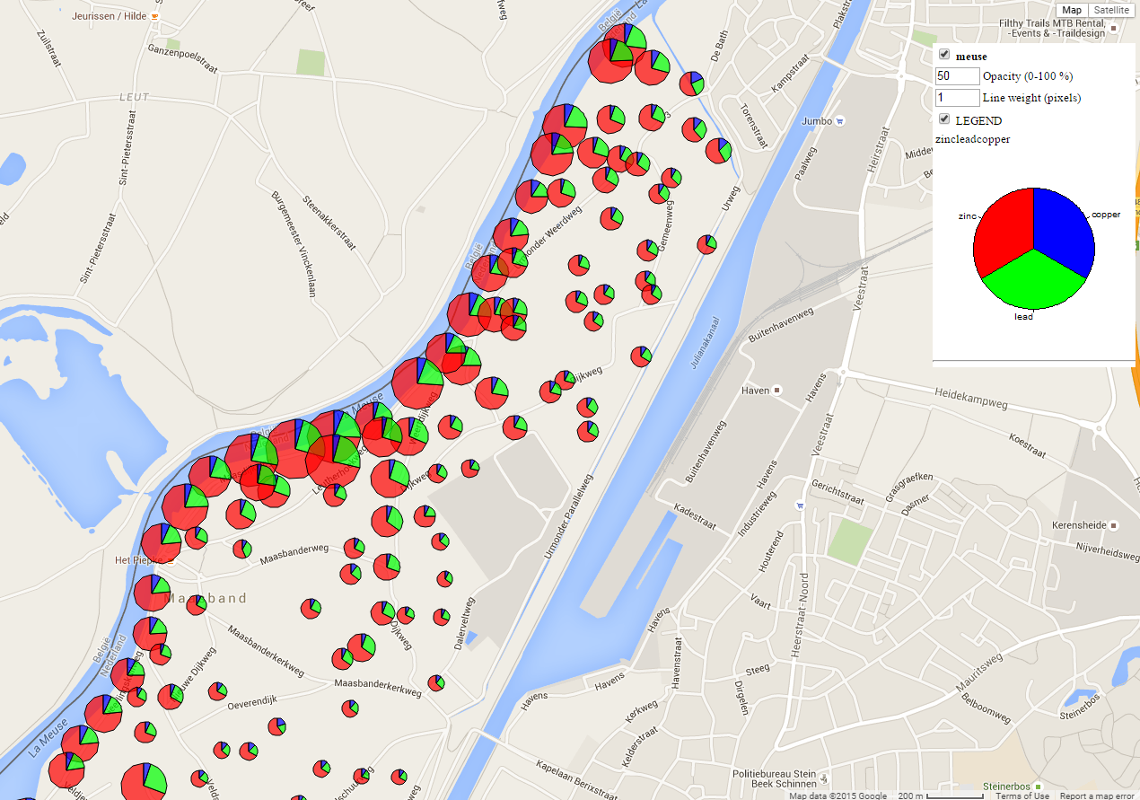
Mapping Point Level Data

Slide 22
Choropleth Maps
Greek: choros (place) + plethos (filled)
These use polygonal enumeration units
e.g. census tract, counties, watersheds, etc. to visualize aggregated data
Data values are generally classified into ranges

Slide 23
Unemployment Rates 2016

Slide 25
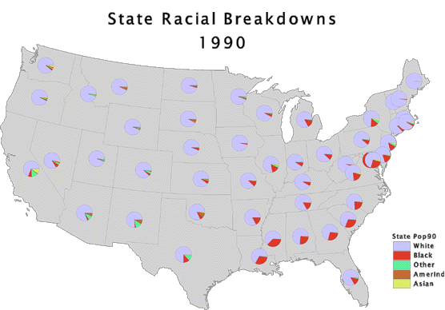
Mapping Multivariate Data

Slide 26
Disadvantages
Assumes mapped data are uniformly distributed in each unit – not usually true!

Slide 27
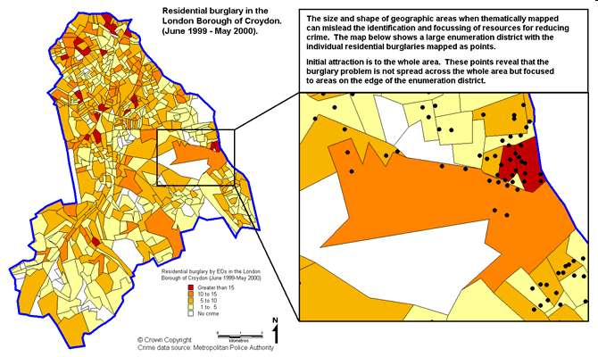
http://www.crimereduction.homeoffice.gov.uk/toolkits/fa020204-map1.htm
Notes:
The map below shows robbery data thematically shaded by enumeration districts across the London Borough of Croydon. A custom range has been used to present the distribution of this crime type. The map serves the purpose of identifying those enumeration districts that are grouped in the highest crime count categories. The map also makes use of natural colours that complement the central message of the map (i.e. where are the hotspots?), and a sensible number of ranges to represent the pattern of this crime across Croydon. When identifying hotspots from this map early attention is drawn to the large enumeration districts that are coloured in the darker orange shading, rather than the EDs of the same colouring but less than a tenth the size. This type of mapping can often mislead identifying and prioritising crime reduction resources to areas that appear as problems, but where the problem is exaggerated from a thematic map of areas of varying size and shapes

Slide 28
Disadvantages
Assumes mapped data are uniformly distributed in each unit – not usually true!
Political boundaries are frequently unrelated to the spatial distribution of the phenomena being mapped

Slide 29
Disadvantages
Assumes mapped data are uniformly distributed in each unit – not usually true!
Political boundaries are frequently unrelated to the spatial distribution of the phenomena being mapped
Large polygons tend to dominate the display

Slide 30
Disadvantages
Assumes mapped data are uniformly distributed in each unit – not usually true!
Political boundaries are frequently unrelated to the spatial distribution of the phenomena being mapped
Large polygons tend to dominate the display
Highly skewed data are difficult to display using a finite number of colour shades

Slide 31
Cartograms
Overcomes problem of physical dominance of large areas
Geometrically transforms the area of each polygon so that it is proportional to the corresponding attribute
Distort area and distance, forsaking spatial detail
See www.worldmapper.org

Slide 32
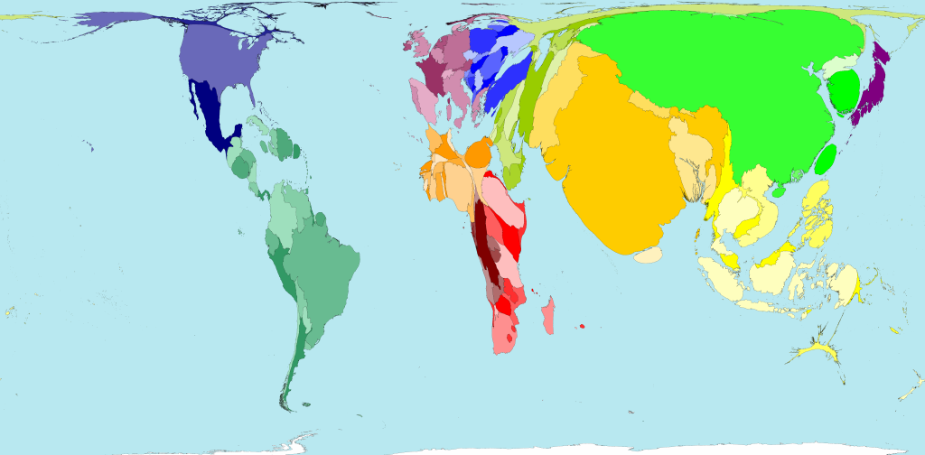
Road traffic accidents
Territory size shows the proportion of all road traffic accident deaths worldwide that occurred there.

Slide 33
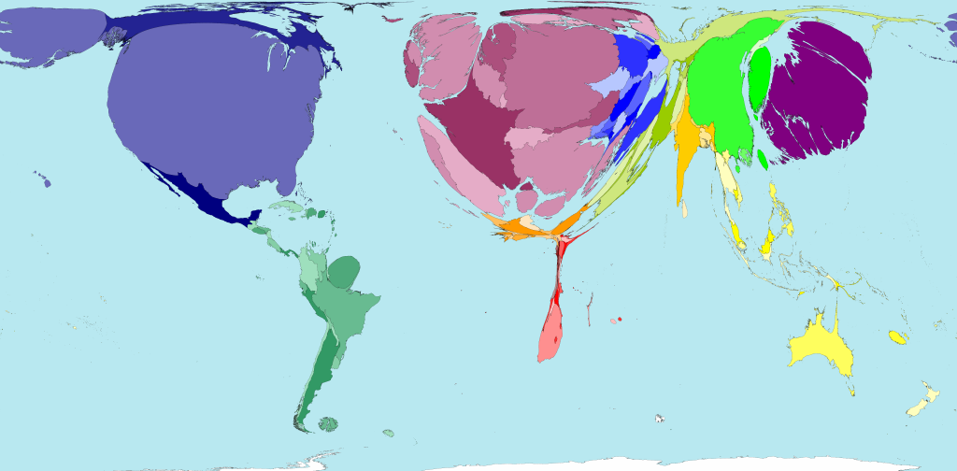
Public health spending
Territory size shows the proportion of worldwide spending on public health services that is spent there. This spending is measured in purchasing power parity.

Slide 34
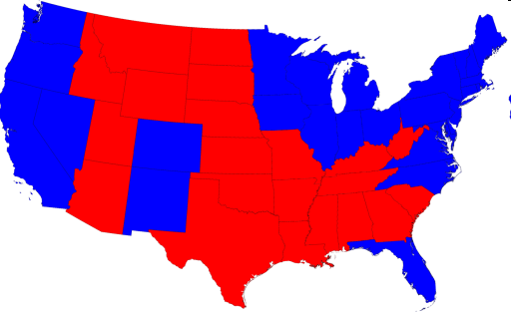
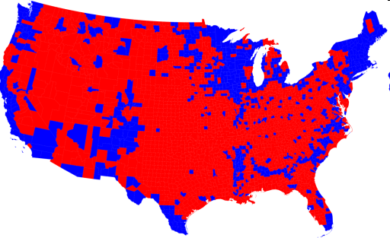
2008 Presidential Elections
Choropleths:
http://www-personal.umich.edu/~mejn/election/2008/

Slide 35
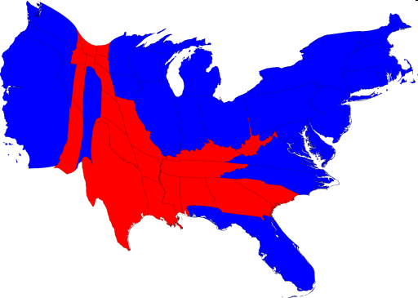
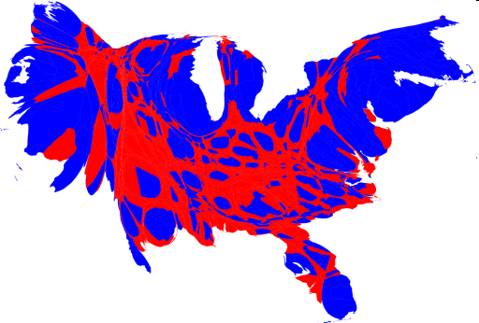
2008 Presidential Elections
Choropleths:
Cartograms:
http://www-personal.umich.edu/~mejn/election/2008/

Slide 36
Modifiable Areal Unit Problem (MAUP)
What is it?
Observed patterns may be as much a function of the chosen zone boundaries as the underlying spatial distribution
Can cause problems later during analysis via:
Scale Effects
- variation in numerical results that occurs due to level of aggregation used in an analysis
(B) Zone Effects
- variation in numerical results that occurs due to regrouping of data into different configurations at the same scale

Slide 37
Modifiable Areal Unit Problem (MAUP)
10
15
5
5
10
15
6.66
11.66
6.66
Scale effect
5
10
5
x=8.88; n=9
x=8.33; n=3
12.5
7.5
11.25
8
Zone effect
6.66
7.5
x=8.47; n=3
x=9.33; n=3

Slide 38
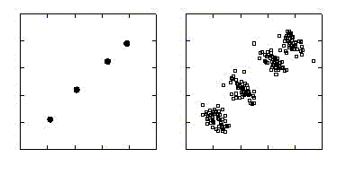
Ecological Bias
Describes the difference between estimated associations based on aggregate- and individual-level data
Country
Individual
Outcome
Exposure

Slide 39
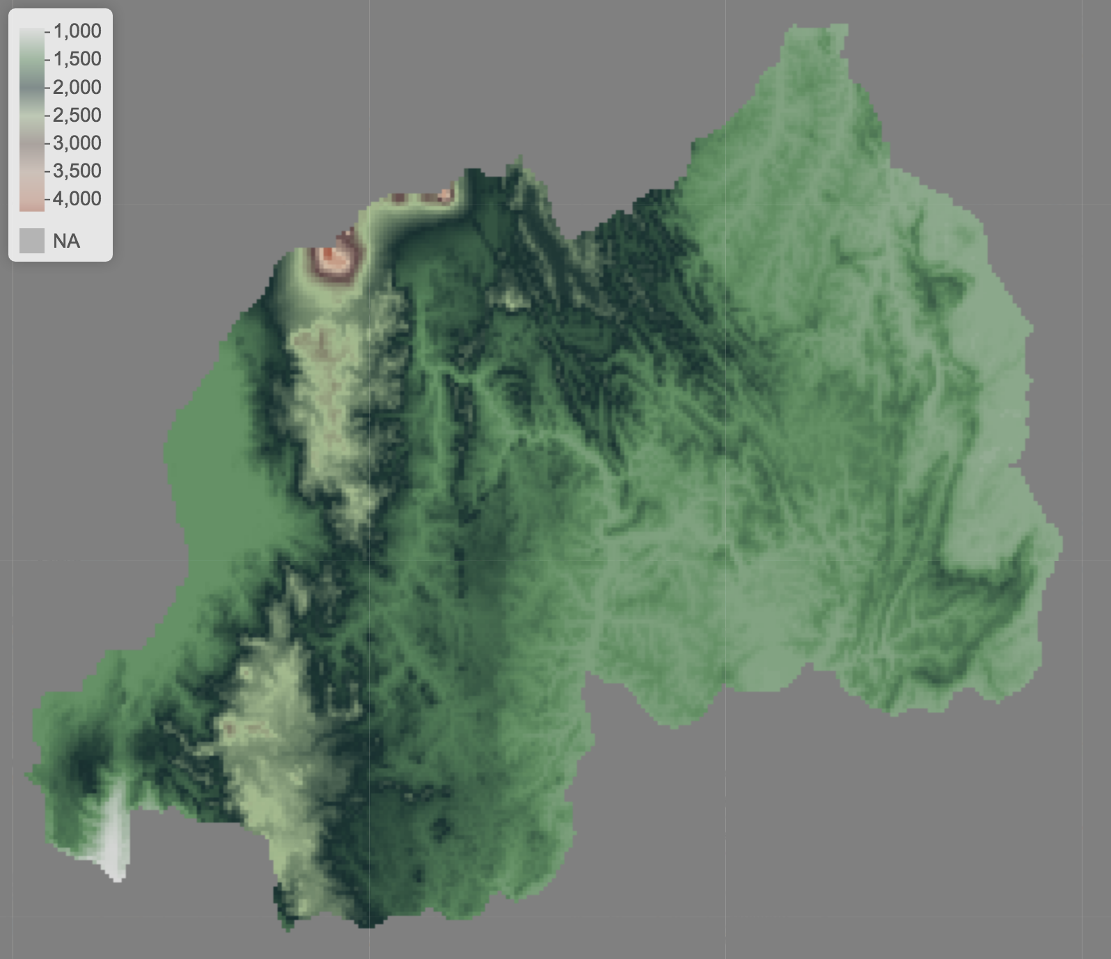
Spatial Data: Raster
For example, remotely sensed data – provide complete coverage at the spatial resolution of the sensor
Elevation in Rwanda

Slide 40
Visualization
Exploration
Analysis

Slide 41
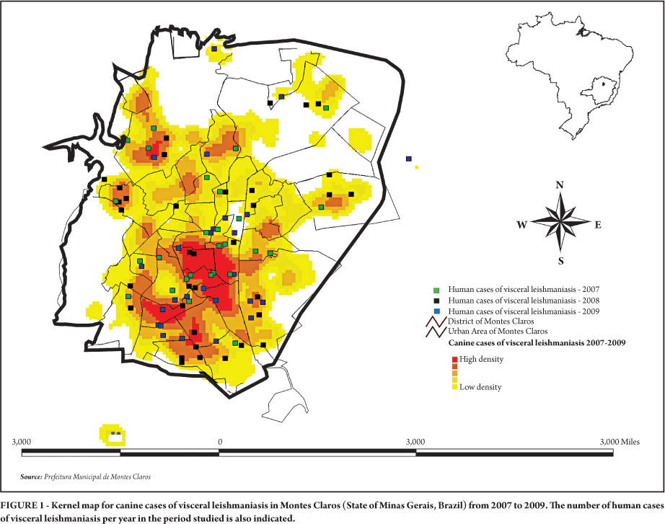
Density Estimates
Fernandes do Prado et al 2011 Rev. Soc. Bras. Med. Trop. vol.44 no.5

Slide 42

Density Estimates

Slide 43
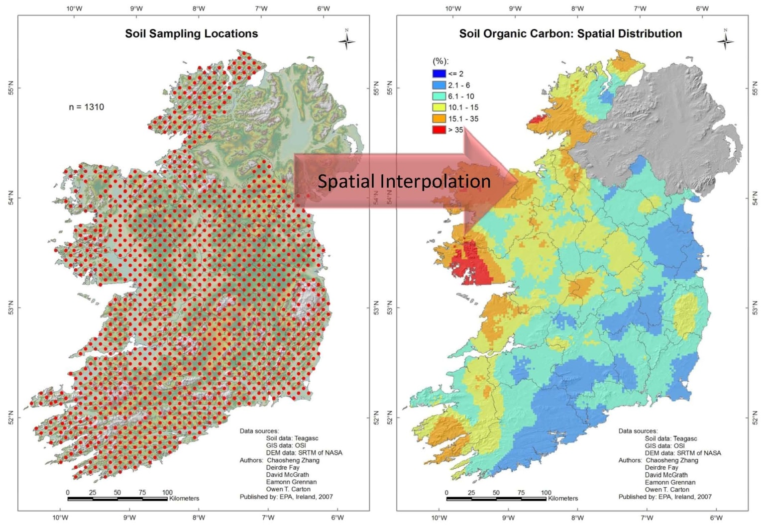
Interpolation

Slide 44
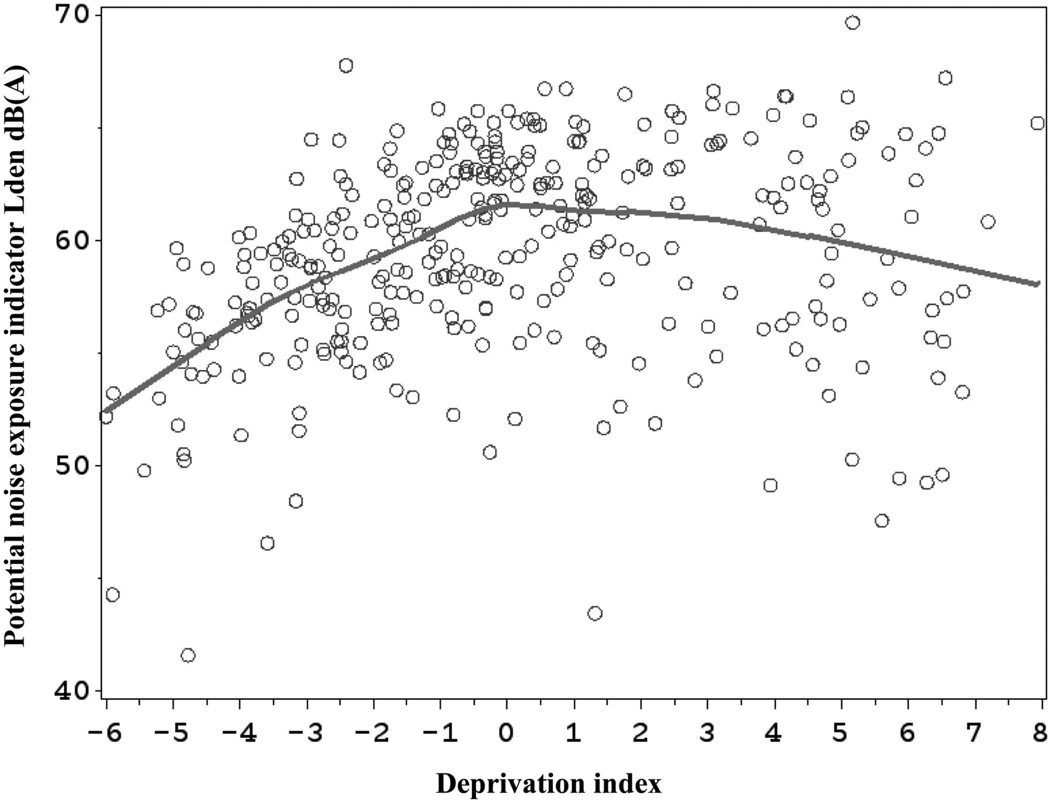
Exploring Relationships
Prevalence of infection
Exposure

Slide 45
Visualization
Exploration
Analysis

Slide 46
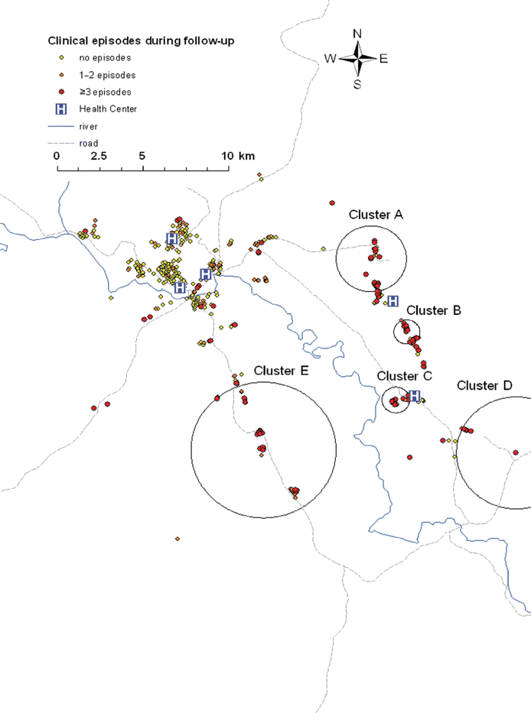
Cluster Detection
Bousema et al Journal of Infectious Diseases 201.11 (2010): 1764-1774.

Slide 47
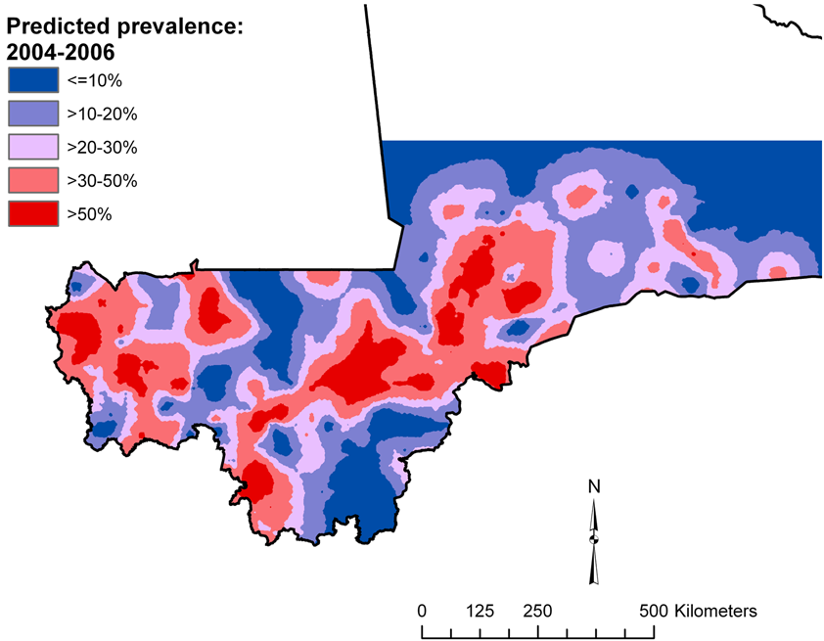
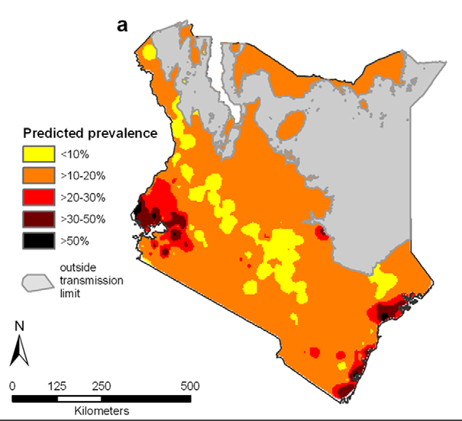
Risk Mapping
Schistosomiasis in Mali
Clements et al (2009) PLoS Negl Trop Dis 3(5): e431
Intestinal worms in Kenya
Pullan et al (2011) PLoS Negl Trop Dis 5(2): e958

Slide 48
Spatial Data Filetypes
Spatial Epidemiology in R
EPI 264 – Week 1
Fall 2019

Slide 49
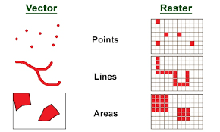
Data Representation
There are two main ways to portray real-world data: vector format and raster format.
Vector Format:
Space is defined by representing geographic features as:
Points
Lines
Polygons
Points are represented by a coordinate pair
Lines and polygons are represented as ordered lists of vertices
= houses (point)
= river (line) = lake (polygon)

Slide 50
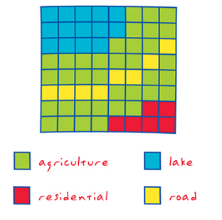
Data Representation
There are two main ways to portray real-world data: vector format and raster format.
Raster Format:
Space is defined as an array of equally sized cells arranged in rows and columns.
Each cell contains an attribute value and location coordinates.
Groups of cells that share the same value represent the same geographic feature.

Slide 51
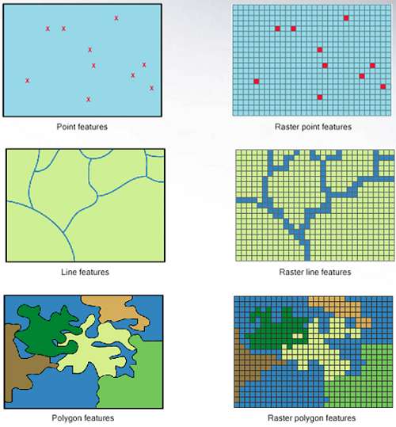
Attributes are associated with each vector feature vs attributes are associated with grid cells.

Slide 52
Shapefiles
For vector data
Made up of four files:
.shp - shape format; the feature geometry itself
.shx - shape index format; a positional index of the feature geometry to allow seeking forwards and backwards quickly
.dbf - attribute format; columnar attributes for each shape, in dBase IV format
.prj – projection

Slide 53
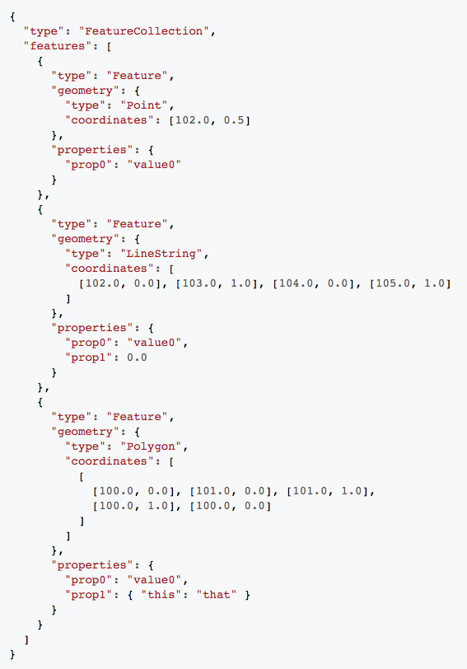
GeoJSON
JSON (JavaScript Open Notation) -
file containing information on geometry and attributes
For vector data
Essentially a single text file
Language of the web

Slide 54
Raster Files
ESRI Grid – proprietary binary andmetadataless ASCII raster formats used by ESRI
GeoTIFF –
TIFF variant enriched with GIS relevant metadata
IMG – ERDAS IMAGINE image file format

Slide 55
In R
All these file types can be read into R
Vector data held as ‘Spatial’ objects using the “sp” package
SpatialPoints
SpatialPolygons
SpatialLines
If present, attribute data are held in associated data.frame
E.g. SpatialPointsDataFrame
Raster data held in ‘raster’ object
RasterLayer or RasterStack (several layers stacked together)

Slide 56
Questions?

